Slide 1
Scientific Approaches to Cybersecurity:
Design and Analysis of Complex Digital Systems
SAND2017-6338PE
Robert Armstrong and Jackson Mayo
Sandia National Laboratories, Livermore, CA
May 24, 2017

Slide 2
What makes cybersecurity hard?
We need to model cyber systems to say anything scientific about them, but models of digital logic behave differently from most models used in science
Or to put it another way: Cybersecurity is a complex systems problem
Not just digital logic – also need to model:
  Human users and attackers
  Supply chain (how the system came to be)
  Physical infrastructure that the system interacts with (e.g., SCADA)
We consider “trust” as a generalization of security that includes potential attacks during the creation of the system (e.g., planted vulnerabilities)

Slide 3
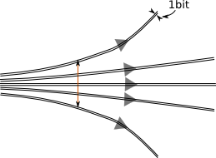
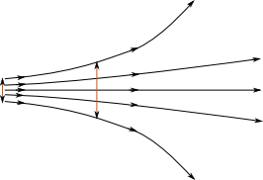
Cyber: inherently stable to < 1 bit, usually chaotic to > 1 bit perturbations
Cyber systems are both unpredictable and deterministic
  Hard, at first, to wrap your head around
The same input to a generic program always outputs the same result
A one-bit variation in the program, or just the input to the program, produces wildly different results (Lyapunov exponent > 0)
Chaotic dynamical system
Generic digital system

Slide 4
Finding the right approach for the job
Sandia is interested in cyber systems broadly, but especially in digital controllers for high-consequence physical systems
There are at least three levels of scientific inquiry on the security of cyber systems:
  Simulation and testing of particular (existing or proposed) cyber systems
    Explores behaviors one at a time; by itself can’t assess security quantitatively
  Mathematical analysis of particular (existing or proposed) cyber systems
    Seeks to establish security as a quantitative global property of a model
    Well-established example: mathematical proofs of cryptographic security
  Design of new cyber systems that are “secure by construction”
    Creates a system in a mathematically constrained fashion so the desired properties are built-in
The adequacy of the model (verification and validation) is a perennial problem!
  The most rigorous analysis may be irrelevant if an attacker can operate outside the model (see $5 wrench)

Slide 5
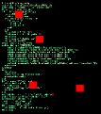
Economies of scale in computing:
Friend and enemy
Enormously complex hardware and software is created at enormous cost
  Cost is recouped by stamping out millions of identical copies
A kid in his basement can make it do something interesting but unknown (unpredictable). He can be certain he can do the same thing to your desktop PC (deterministic)
In the general case, all digital designs share these problems
Solution: Make the design less general, more analyzable

Slide 6

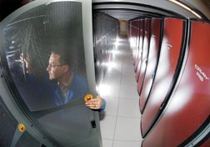
Digital systems are prototypical of broader complex systems
One way of defining “complex” systems: those that behave as large-scale information networks and do not yield to traditional equation-based analysis
  Complex systems can be engineered or evolved
Fundamental basis for their intractability: Turing’s halting problem
  Once a system (whether designed with digital logic or otherwise) is equivalent to a sufficiently powerful computer, its behavioral properties cannot be predicted in the general case
  The digital cybersecurity problem illustrates this difficulty in its purest form
Infrastructure
Computers
Societies

Slide 7
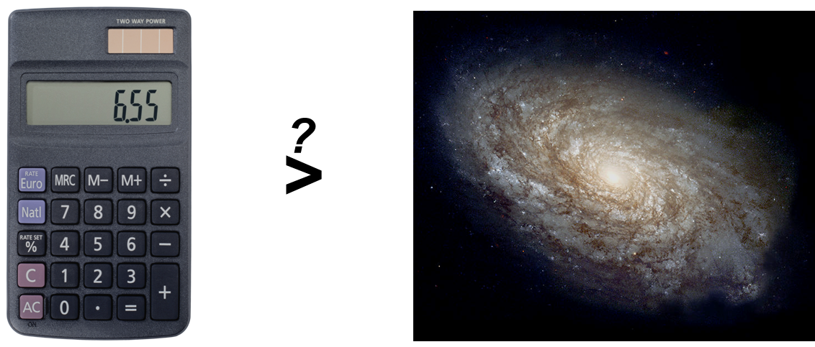
The complexity problem has its roots in theoretical computer science
Theorem (Turing 1936, Rice 1953): No algorithm exists to predict
a priori the behavior of a generic information processing system
  i.e., such a system is undecidable even if deterministic
  Practical significance: A real system, with a finite exponentially large number of states but otherwise generic, is effectively undecidable – in particular, simulation or testing cannot tell us all its possible behaviors
We need to bound all possible behaviors to quantify safety and security
2³⁰⁰ states

Slide 8
The theory has direct engineering implications
A digital system created arbitrarily cannot be predicted or bounded
  You have no idea how the system will respond to the vast number of inputs you haven’t tested
  This explains why bugs and vulnerabilities are commonplace
  Once the state differs by even one bit from what you expected – due to a mistake, a natural fault, or an attack – all bets are off
We need ways to tame this “wild west” digital complexity
We must design digital systems specifically for analyzability and robustness
Similar problems are faced in outside applications, but Sandia faces them in extremes
  Extreme consequence, extreme environments, extreme scale

Slide 9
The solution space uses the mathematics of complex systems
Formal methods (reduced complexity)
  Automated reasoning about all possible behaviors within a model – widely used in industry for critical digital devices
  Model checking, theorem proving
  Scaling limitations, though power and tractability have improved over time
Complex systems theory (structured complexity)
  Probabilistic analysis of response of networks to perturbations
  Biologically inspired architectures such as diversity
  Well suited to understand emergent system-level robustness, but only sparingly applied to engineered digital systems
In both strategies, systems must be constrained to be analyzable
  Ideal approach is to consciously design-in analyzability and robustness along with functionality

Slide 10
Formal methods reason about all possible digital behaviors
Example: Can this 63-input logic circuit ever output TRUE?
(b₁ XOR b₂) AND (b₂ XOR b₃) AND (b₃ XOR b₄)
AND … AND (b₆₂ XOR b₆₃) AND (b₆₃ XOR b₁)
Exhaustive black-box testing:
  Try all 2⁶³ ≈ 10¹⁹ input values to conclude: no, never outputs TRUE
Automated reasoning by a formal “satisfiability (SAT) solver” that seeks a TRUE output (common off-the-shelf tool):
  Try b₁ = TRUE: then b₂ = FALSE, …, b₆₃ = TRUE, b₁ = FALSE: contradiction
  Try b₁ = FALSE: then b₂ = TRUE, …, b₆₃ = FALSE, b₁ = TRUE: contradiction
  This is a proof that no input can make the circuit output TRUE, based on analyzing the circuit as a mathematical object

Slide 11
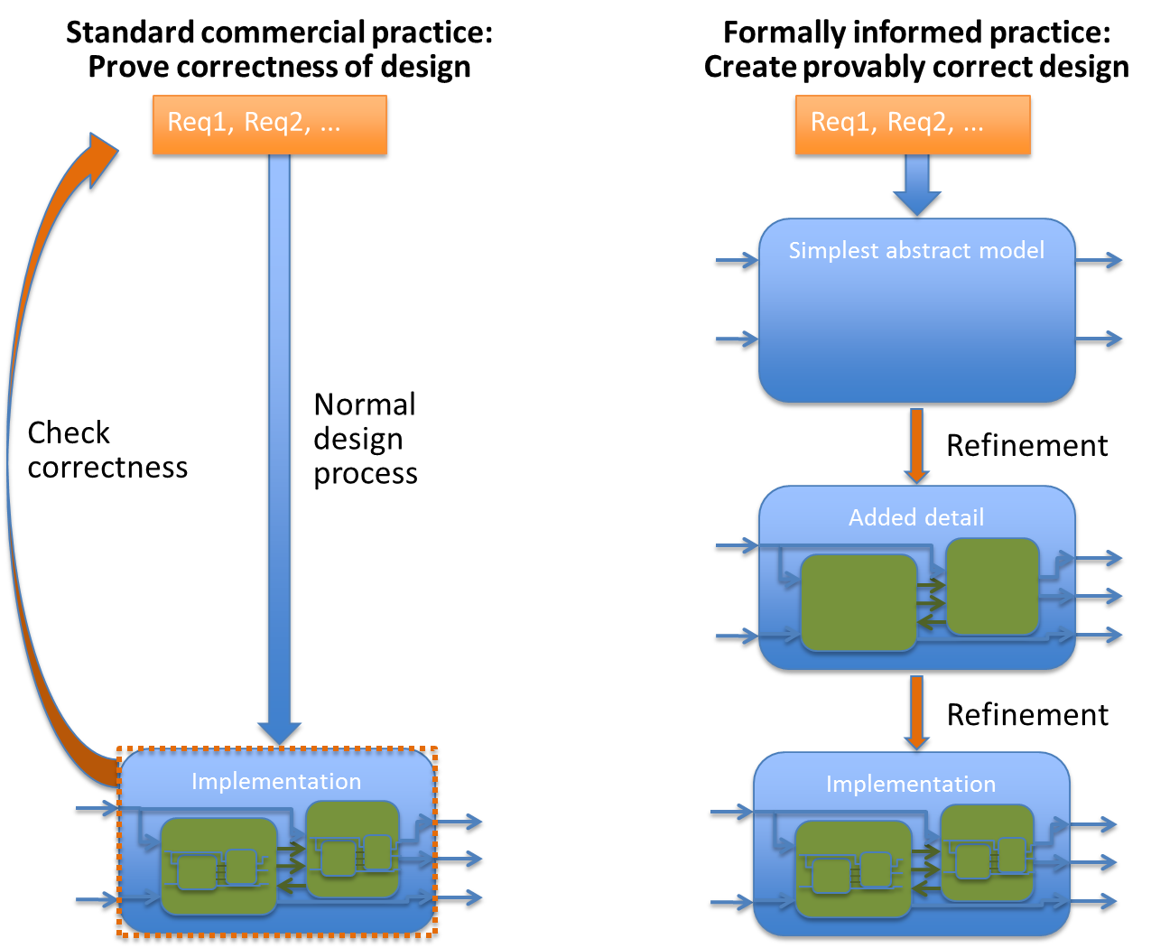
Work aims at “engineered trust” via formally informed design
Increase proof tractability for
highly stringent requirements

Slide 12
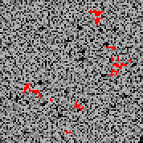
“Self-organized criticality” is a simple example of digital emergent behavior
​SOC (Bak et al. 1987) is spontaneous development of fractal phenomena with power-law distributions
  Similar to thermodynamic criticality but without tuning
System shown is “Sandbot”: cyber model of coordinated malware
Inspired by “sandpile model”: physics-like cellular automaton
  Sand is sprinkled randomly
  Avalanches occur at all scales
8100 machines running Sandbot:
Each pixel is a single machine;
network storms appear in red

Slide 13
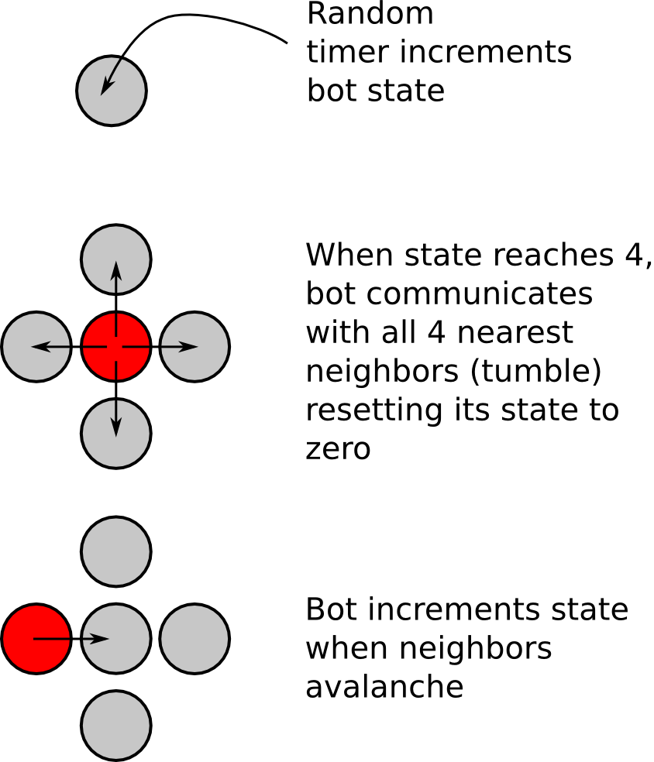
“Sandbots” communicate via standard protocols and obey simple rules
Simple “botnet” is based on a square lattice populated by bot nodes
Simple rules determine when a bot communicates with its 4 neighbors
Despite the model’s simplicity, behavior at large scale is unexpected and rich
The model has been implemented using emulation, in which a computer uses “virtual machines” to perform an extremely faithful simulation of other computers

Slide 14


Robustness is key to understanding systems with “organic” behavior
Highly optimized tolerance (HOT, Carlson & Doyle 1999): Systems designed or selected to perform well despite perturbations
HOT systems exhibit power-law distributions but have organic structure (not self-similar or fractal)
Adapted robustness to one set of perturbations induces extra fragility to different perturbations
Indeed, rare but catastrophic failures are seen in highly engineered/evolved systems
  Electrical blackouts, financial panics, epidemics, massive cyber attacks, etc.
HOT
≠
Fractal

Slide 15
Complexity theory shows ways to address “whole system” robustness
Cybersecurity vision: Create high-consequence digital systems in new ways, so that they are analyzable
  Seek to understand computers as dynamical systems
Toy example: “Growing” a digital circuit to add two 1-bit numbers – a half adder
There are many ways of composing logic gates to implement this functionality
Next slide shows two such “grown” (actually randomly sampled) networks; each performs as a half adder when run for 20 steps
  Shown correctly adding 1 + 1 to get the binary result 10
  They also respond correctly to the other possible inputs

Slide 16
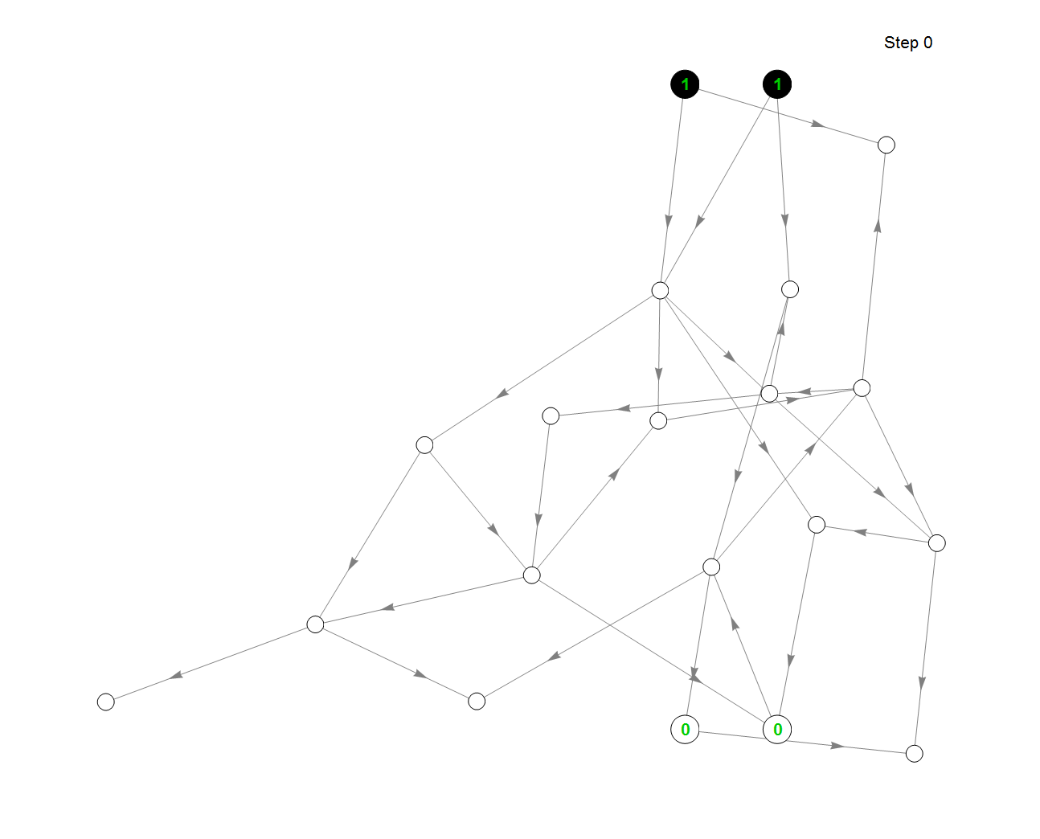
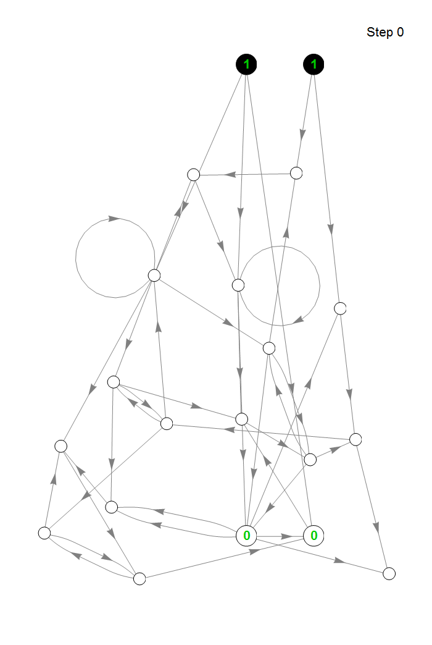
A
Inputs
B
Inputs
Outputs
Outputs

Slide 17
What distinguishes the two implementations? Resilience
Resilience of a digital model to bit errors can be assessed via growth or damping of perturbations (“Lyapunov exponent”)
  Bit errors can represent breakdown of digital model, or effect of untested states within the digital space
  Networks transition from stable to unstable based on connectivity and logic (generalizing Kauffman 1969)
Next slide: runs with 1% error rate per update
  States that deviate from the ideal run are outlined in red
Network A has much less error in final output (greater resilience) than network B – why?
  Here, average inputs per node (k) makes the difference

Slide 18
k = 1.5
k = 2.5
A
Inputs
B
Inputs
Outputs
(Average incorrect bits: 0.10)
Outputs
(Average incorrect bits: 0.73)

Slide 19
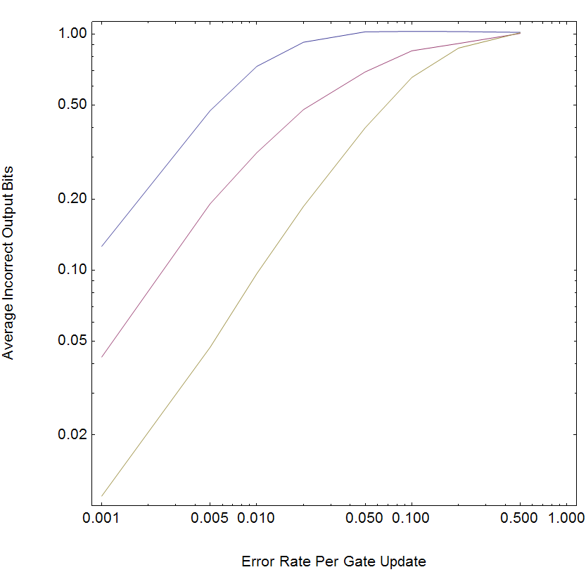
Example illustrates quantifying resilience implications of designs
Results for these half-adder networks can be obtained by brute testing
Systematic relations to real-world design parameters enable assessing potential catastrophic failures too rare to be found reliably through testing
k = 2.5 (B)
Cases shown
k = 2.0
k = 1.5 (A)

Slide 20
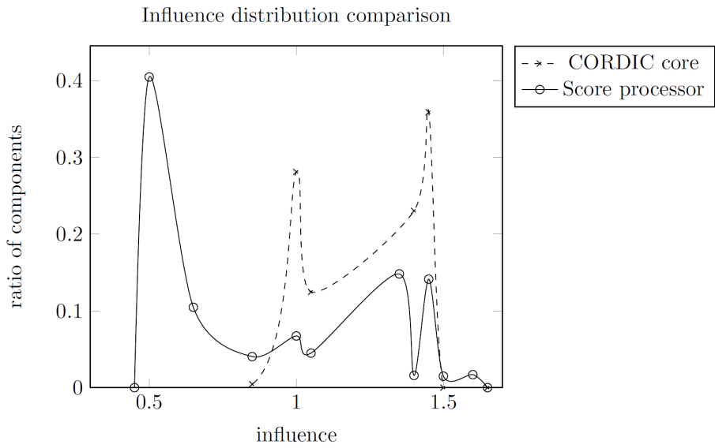
Complexity theory provides insight on real-world circuits
“Influence” measure in BNs is a more precise generalization of “inputs per node” (Seshadhri et al. 2011)
  If Avg. Influence > 1 (supercritical), network is unstable
  If Avg. Influence < 1 (subcritical), network is stable
Example: Score processor shows signs of enhanced resilience – consistent with its goals of analyzability and predictability
Score is
subcritical
(prototype
analyzable
processor
for Sandia
applications)
Critical
threshold
Score avg.
CORDIC avg.
CORDIC is
supercritical
(typical
off-the-shelf
circuit design)

Slide 21
Area for research: What makes resilient complex systems quantifiable?
Smoothness (a.k.a. stability, subcriticality) makes a system:
  Predictable (you can extrapolate its behavior to a new situation)
  Resilient (it tends to maintain its behavior under minor faults)
  Evolvable (you can make small changes to it, and it remains usable)
Smoothness of particular observables is common in physics
  Amid molecular chaos, continuum equations apply when we’re concerned with thermodynamic (averaged) behavior
  Extend this to adaptive complex systems with respect to the behaviors that are selected for? (These are typically not averaged behaviors)
Ability to bound the effect of perturbations is crucial for:
  Inferring that a model will be predictive under conditions that differ from those used to test it (V&V), and inferring how much the model behavior may change due to variations in input parameters (UQ)

Slide 22
A lesson for complex systems that are not resilient
Beware of applying techniques that assume smoothness/ stability to complex system observables that have no reason to be smooth/ stable
  Could be garbage in, garbage out
Today’s complex digital systems are not designed in a thoroughly adaptive way, and lack inherent stability
  Hence, highly susceptible to failures and attacks
  By the same token, also difficult to model predictively
The difficulty of V&V’ing cyber(-physical) models and the difficulty of securing cyber(-physical) systems are two sides of the same coin
  The cyber V&V problem is the cybersecurity problem – both need to be solved together

Slide 23
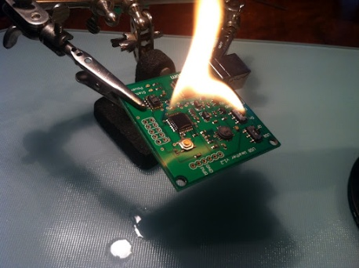
Complexity theory enables analysis of the consequences of hardware errors
Digital hardware is generally unpredictable
  Even when it’s working as designed
    Complexity can exceed the reach of formal methods
  But doubly so when hardware is compromised
    Due to out-of-spec extreme conditions
    Radiation, thermal, intentional physical subversion
Most tools and applications assume perfect hardware
  Conventional formal methods prove properties for logic working as designed
High-consequence systems require efforts to assure safe behavior in abnormal physical environments
  Especially when coupled to vast digital state spaces in a cyber-physical system
Example: Mixed-signal simulation can elucidate the digital imprint (e.g., bit flip pattern) of a physical insult (e.g., radiation) on a circuit
  Using analog model for the part of the circuit subjected to the insult

Slide 24
Formal analysis can incorporate a digital upset model
Exhaustively prove correct function of example half-adder networks using open-source model checker NuSMV
Currently using simple upset assumption
  Allow any single bit flip within a range of time steps
  To be generalized by extracting upset models from physical simulation
Initial formal results confirm insights from complexity theory
  Chaotic network is susceptible: Corruption can arise from any time step
  Quiescent network can be corrupted only if upset occurs in the last 5 of 20 time steps: self-healing otherwise
tfern02 := (xfer02 >> (n01 :: n03)) & 0ub4_0001;
...
LTLSPEC F ((clock = 20) & (n18 = (n00 & n01)));

Slide 25
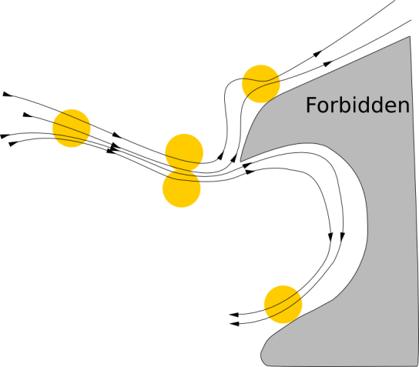
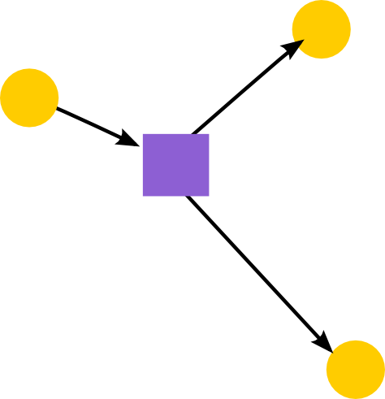
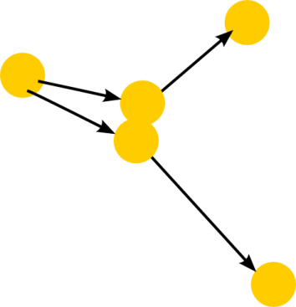
Abstraction/composition is key to analyzing large cyber-physical systems
Abstracting continuous equations into digital representation
Abstracting detailed digital representation into an over-approximation that still permits proofs of key properties
Composition that preserves formal safety/security properties admits a divide-and-conquer approach
Continuous
Digitized
Abstracted

Slide 26
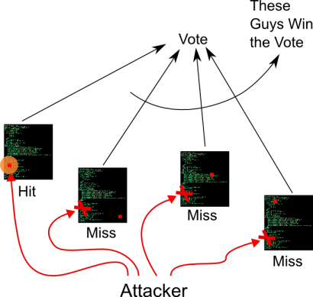
“Diverse redundancy” is a complex systems technique for trust
Use a voting system with members drawn
from a set of implementations
  Input processed by each in parallel
  Outputs compared to determine
  response
  A type of “moving target”
Keep intended functionality
while varying vulnerabilities
over space and time
Similar to redundancy for
physical fault tolerance
Diversity leverages a simple “trust anchor” (the voting unit) for cybersecurity benefits at the complex system level

Slide 27
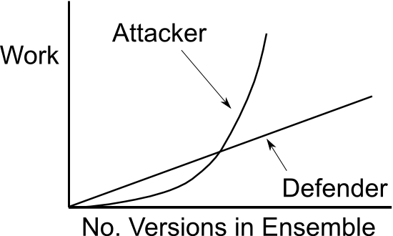
Analyzable statistics arise from an ensemble of undecidable programs
For a specific feature set, there is a probability P_{v} that a particular member of the set of implementations will be susceptible to vulnerability v. For a voting system of size N:
  The probability of success for the attacker is (P_{v})^{N/2}
  The attacker “work” is the expected number of tries: (1/P_{v})^{N/2}
  The work for defender is the cost of producing N implementations: ∝ N
N

Slide 28
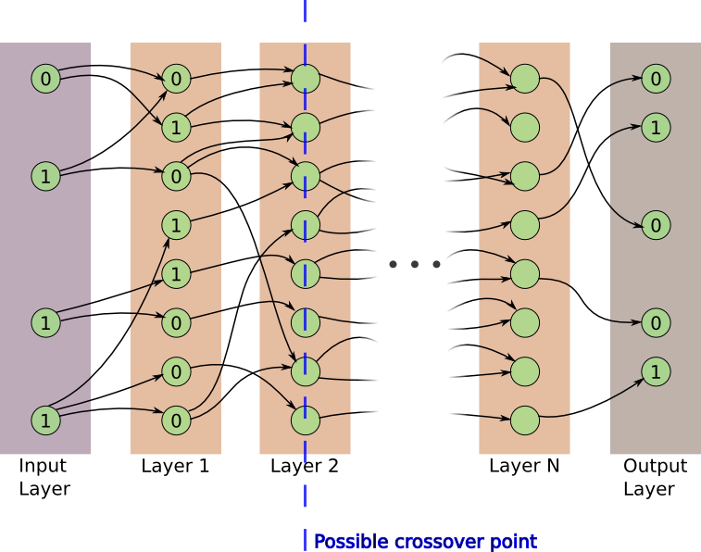
“Genetic programming” can produce diverse digital implementations
Example: “Grow” realistically imperfect circuits represented as BNs
Simple BN specification for “string recognizer”: Output 1 for a particular input bit combination (“password”), 0 for all other inputs
  Faults are inputs other
  than password that
  produce 1
Use “feedforward” BNs
with a modular structure
that can be recombined
genetically, to find many
circuits that perform well
(but not perfectly) in
meeting the specification

Slide 29
String recognizer example illustrates role of testing vs. formal methods
Most error rates for “grown” recognizers < 1%
  Recognizing bit-strings of up to 64 bits long
  Some low bit length (8 bit) strings have zero error rates and are proved by NuSMV to be perfect
The NuSMV model checker itself has perfect logical consistency for every circuit tested (> 7000)
  All recognizer circuits tested to have errors are detected faulty
    Counterexample emitted by NuSMV proves that this is so
  All perfect circuits (whether grown or human made) are proven perfect and have no errors in testing
  Even circuits that have 0 tested errors are shown to be faulty by the model checker
    Examples of 32 bit recognizers show 0 errors for 1000 random tests, yet are shown to be flawed by model checking

Slide 30
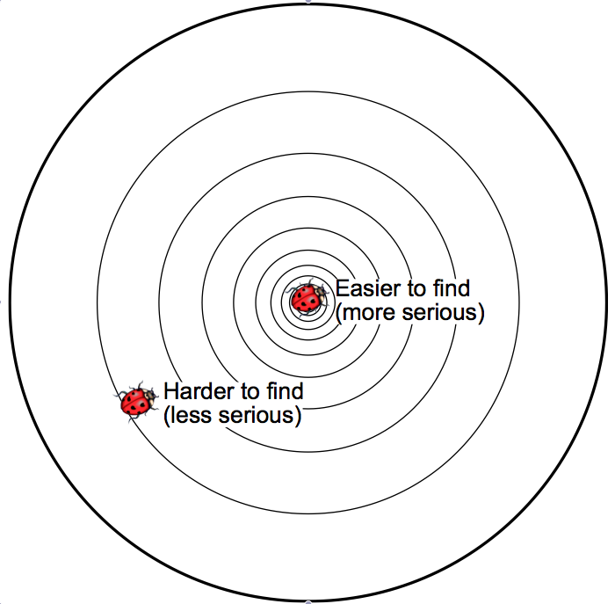
Complexity measures suggest targeted fuzzing strategies
Evolved and designed systems have coherence that makes it useful to fuzz in “simpler” spaces
Example: Fuzzing string recognizer with patterns close to gold string is more likely to find faults
More generally: Inputs that have a simple description (relative to available information) should be targeted for coverage because they form a smaller “corner” space (also more attractive to attacker)
Input space
Simple description
Complex description

Slide 31
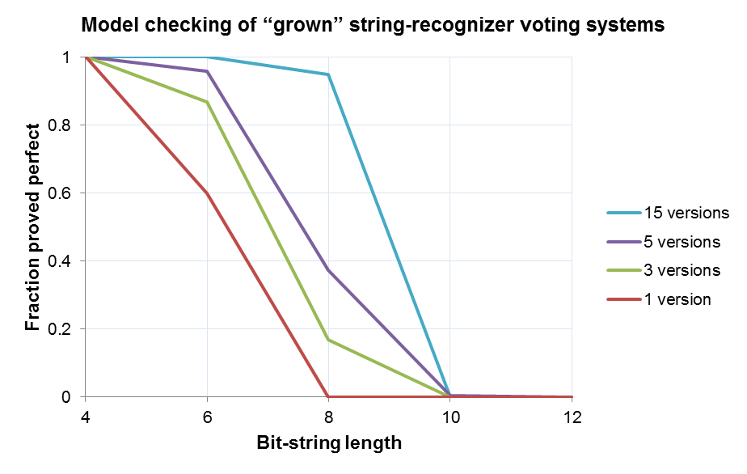
Formal analysis of diverse string recognizers exposes voting benefit

Slide 32
Supplemental slides

Slide 33
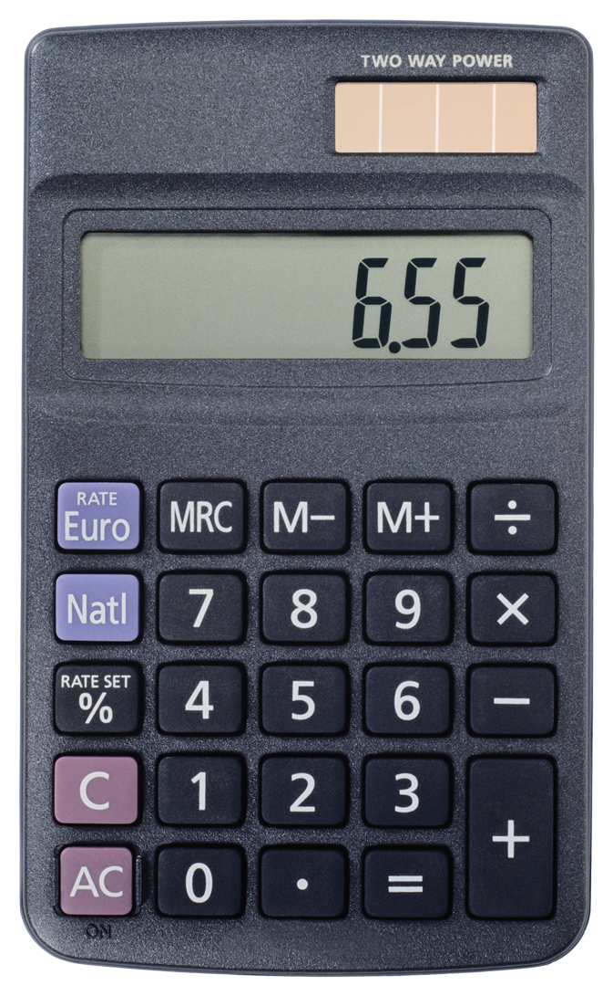
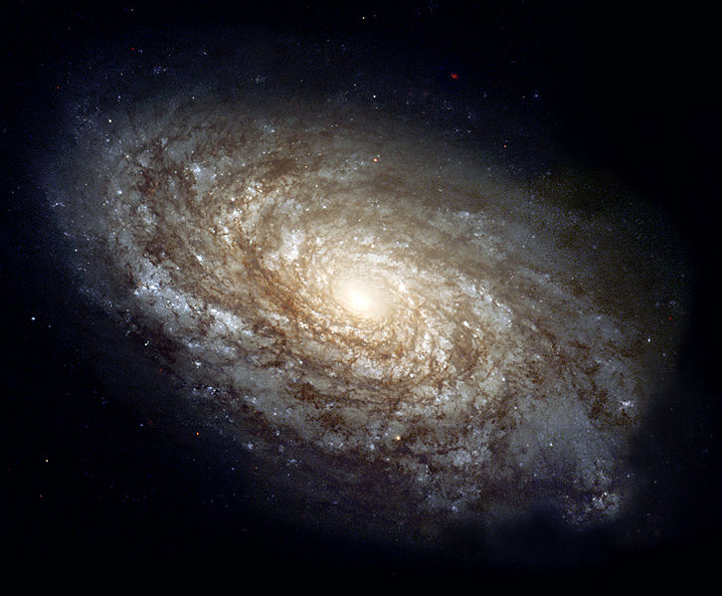


Need to assure trust for high-consequence information systems
As high-consequence systems
incorporate digital components,
exhaustive testing/simulation
becomes infeasible
Assessing trust in such systems is vital for Sandia missions
?
>
Simple calculator has more possible states than number of particles in known universe
Nuclear weapons (NW)
Cyber/computing
Energy infrastructure

Slide 34
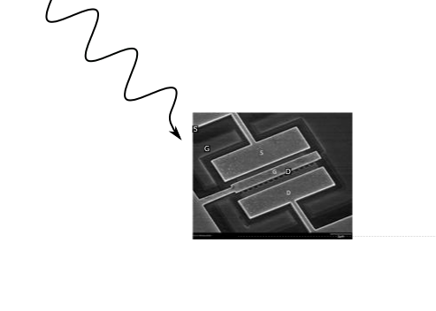
Need to verify increasingly complex behavioral requirements
Analyses often must address system reliability, safety, and security in both nominal and extreme physical environments
Most effort in physical NW design is for extreme environments
  All the more need to address this issue when it’s coupled to a vast digital state space – yielding a cyber-physical system
Formal methods and complexity theory can help address the design space of cyber-physical information systems, verifying requirements infeasible to cover by testing/simulation
  Example coming up:
  Modeling the digital
  response of electronics
  to radiation-induced
  upsets

Slide 35
Need to verify increasingly complex behavioral requirements
Requirements
Complexity
Certain devices inherently lack the complexity needed for certain tasks
e.g., a relay cannot implement a power grid
Kolmogorov
Complexity
Limit
National Survival
Critical Infrastructure
Infeasible Region
Public Safety
A device needs only a given amount of design complexity to implement
a set of requirements
Mission Needs
Medical
Fault
Tree
Formal
Methods
Complexity
Theory
Toy
Commercial Tools
Device
Complexity
Logarithmic scale of:
System requirements
(y-axis)
Device/system used to implement requirements (x-axis)
Relays
ASIC
ARM
Network
Logic Array

Slide 36
Analysis scalability is enhanced by coupling analog and digital models
Goal: Understand the net effect of an out-of-nominal event as an abnormal transition (upset) in a digital state space
Simulate this transition – then use, e.g., a digital formal model to evaluate its consequences exhaustively
Analog simulations of many different upsets can leverage HPC (embarrassingly parallel)
D
010011011...
A
V(t), I(t)
Dʹ
010000011...

Slide 37
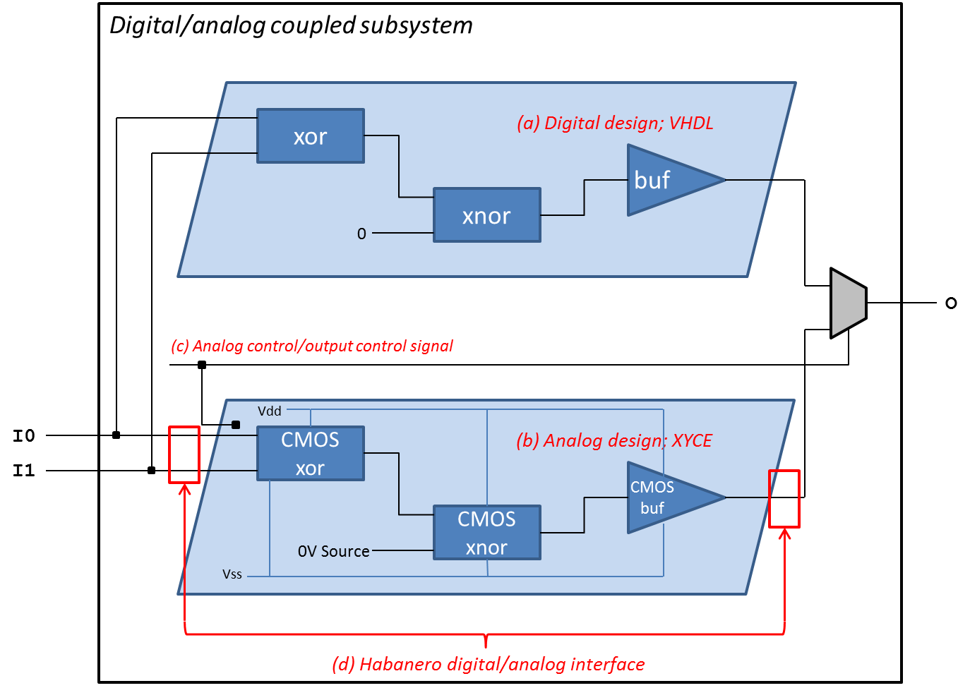
Digital upsets can be generated from physics
Proof of concept uses a toy “half adder” circuit
Introduce “swappable” analog model for one logic element

Slide 38
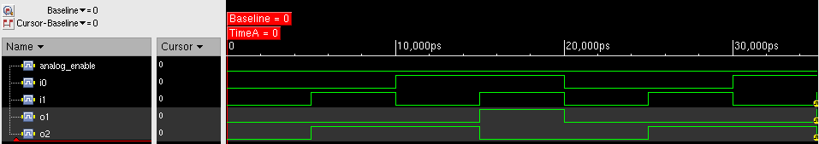
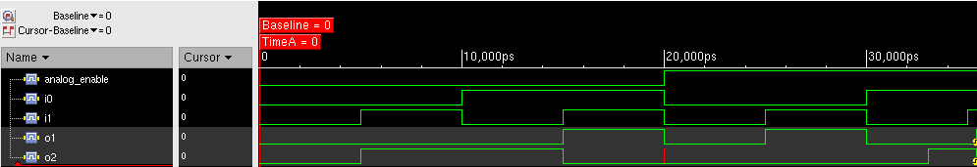
A toy “half adder” circuit illustrates generating digital upsets from physics
In Habanero, simulate a single-event upset by:
  Swapping in an analog model for a selected logic element
  Applying a photocurrent (using an available perturbation in Xyce)
  Re-digitizing the resulting state – output errors are seen
Nominal
With upset

Slide 39
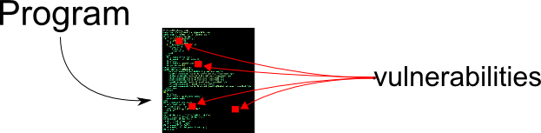
Securing an arbitrary code is not
just hard; it’s impossible
Restated: Generic code has vulnerabilities that are unprovable and unknowable
  Not statistical, even in principle
  Turing completeness demands that a generic code is undecidable
So now what?

Slide 40
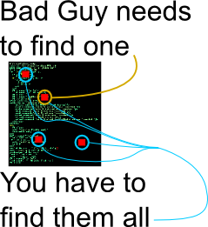
Complexity makes
cyber threats asymmetric
Developer, user, and attacker all don’t know where the vulnerabilities are (undecidable)‏
Worse, attacker may have planted a vulnerability
Asymmetry: One vulnerability compromises the whole code
  Developer has to find all of them (impossible in general)‏
No one can guarantee “this code is clean” or even quantify improvement

Slide 41
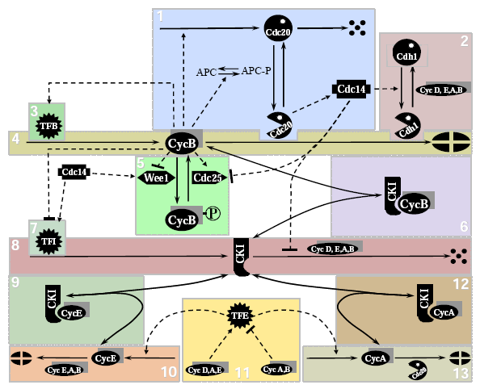
Complexity is a fact of “life”
Biological phenomena are a prototype and inspiration for many complex domains
  Life involves a large chemical regulatory network
  “Game of Life” model is based on population dynamics
  Bio concepts pervade computing (viruses, mutations)
Biology typifies complex couplings of manmade systems – economy, energy, cybersecurity
Eukaryotic cell-cycle regulation

Slide 42
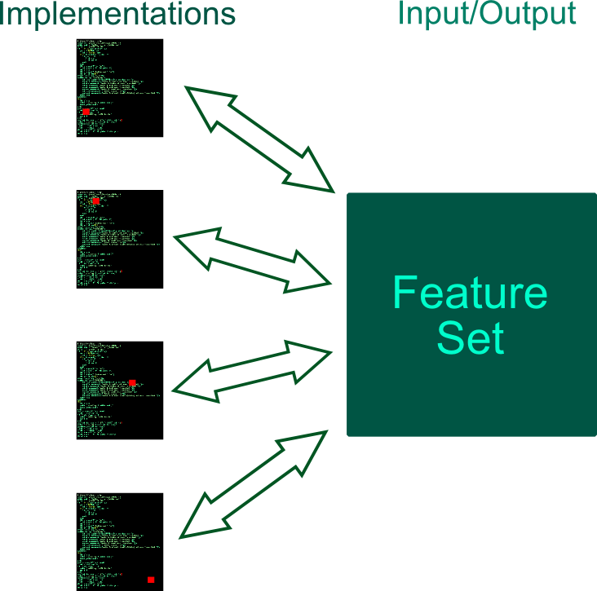
Observation #1: A program’s
feature set has many implementations
Feature set is defined by a test suite
Test suite verifies that an implementation conforms to desired functionality
Test suite is a sample; cannot realistically cover all possible input/outputs
Vulnerabilities arise from untested input/outputs
Any feature set has infinitely many implementations
  Finite large number if size is bounded

Slide 43
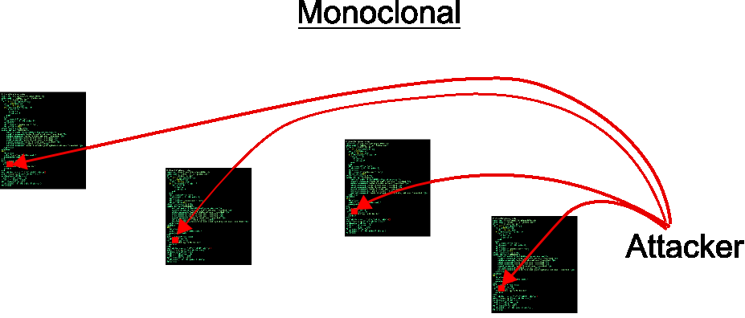
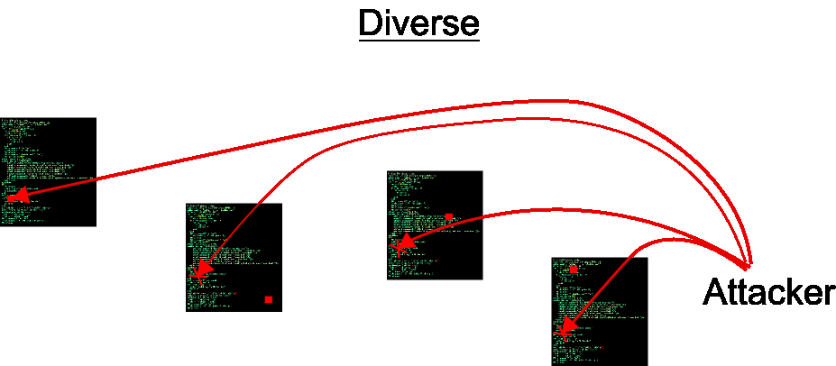
Observation #2: Ensemble of instances permits the formulation of statistics
Assume: Multiple implementations randomize security holes
Ensemble of multiple-version, “randomized” undecidable codes allows formation of security improvement statistics

Slide 44

High-reliability systems can be
constructed from “N-version software”
Space Shuttle: 4 computers, identical
software, different hardware, same design
  Focus is on hardware faults
Similarly, software redundancy used mostly
for control systems up to now
  N-version software: Multiple versions implemented to the same feature set by different developers
Models of N-version software view the control system as a stochastic process that walks the code graph of the software
  Control system takes the place of a “fuzzer”

Slide 45
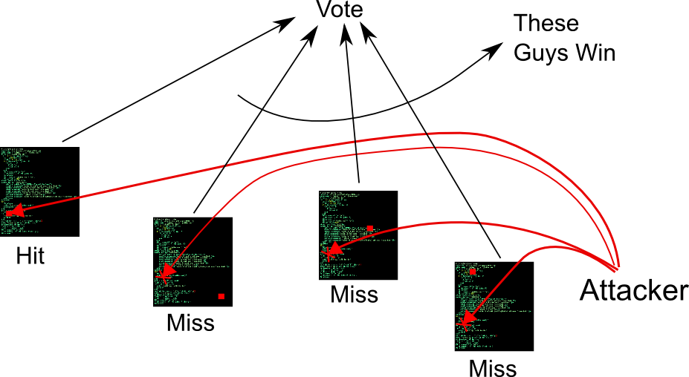
Similarly, N-version software can quantifiably improve cybersecurity
Clear generalization of N-version reliability to cybersecurity …
… but there are important differences requiring enabling technology
  Compromised versions must be removed and replaced
  Hand-made new versions are time-consuming and expensive
    May repeat previous mistakes

Slide 46
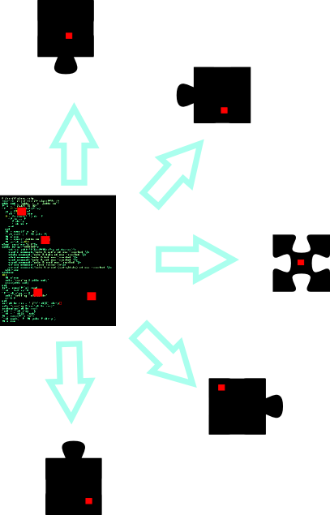
A simple example: Diverse software
can be constructed from components
Component-based codes automatically conform to a feature set if the constituent components conform to their individual feature sets (semantic interfaces)‏
  Multiple implementations of the code amount to multiple versions of components
  Components can be mixed and matched to form a combinatorial number of code implementations

Slide 47
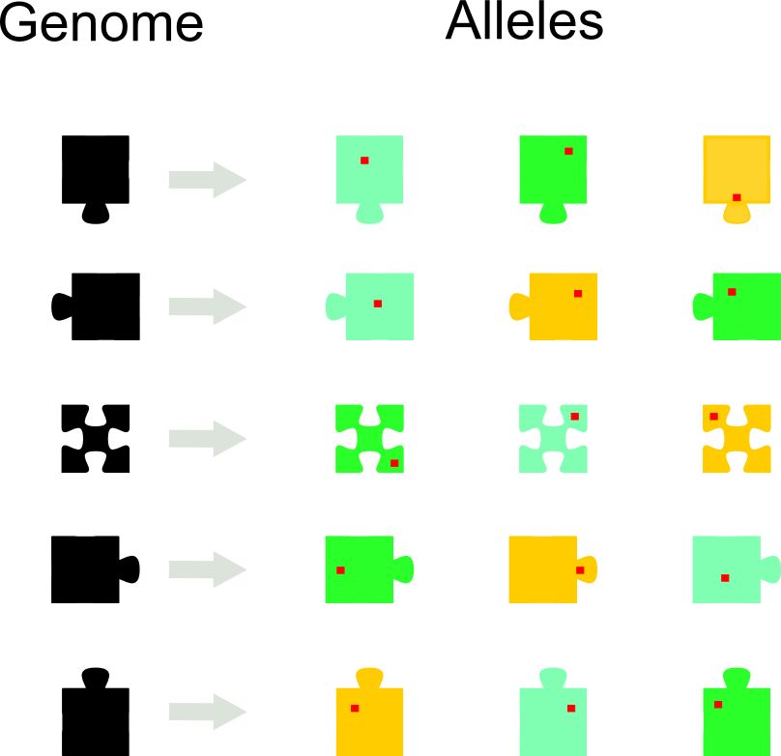
Living systems adapt to cope
with unknowable attacks
A component type is similar to a gene; component implementations are similar to alleles of a gene

Slide 48
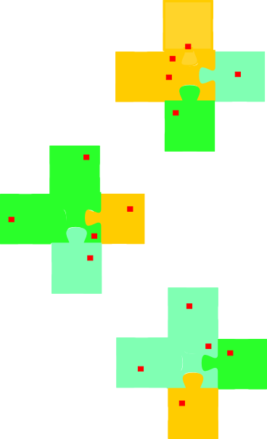
Reassemble alleles into individuals
Different alleles can be assembled into new individuals that have “randomized” security holes
New individuals are differently vulnerable and potentially adaptive
Excess functionality and planted vulnerabilities can be “annealed” away

Slide 49
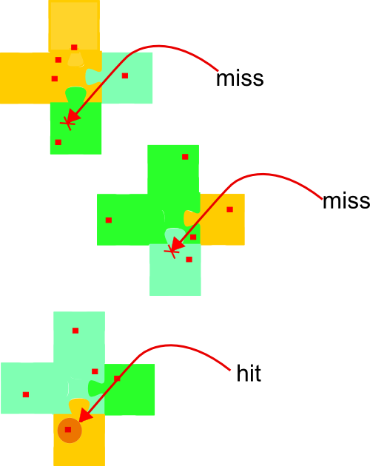
Compare responses from individuals
Now different individuals will produce the same feature set but react differently to attacks

Slide 50
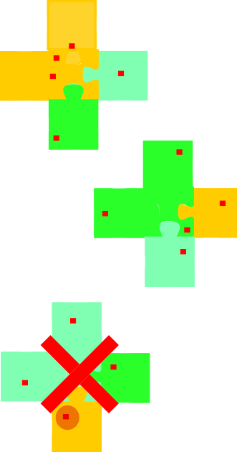
Evolve new and more robust
individuals
Eliminate the one with the differentiated response

